Slide 1
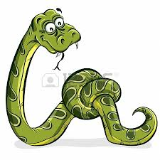
“Not”s In the Devil’s Tale
surely will not die Gen 3:4
will not be in lake of fire Rev 21:8
2 Cor 11:2-4 do not repent Acts 3:19
has not been baptized Mk 16:16
you do not continue Col 1:23
not commit adultery Mt 19:9
not one body Eph 4:4
not one hope Eph 4:4
not one faith Eph 4:5
not one baptism Eph 4:5

